Slide 1
Amark Logistics Inc. TMS and Operational Overview
“The Life Cycle of a Shipment”

Slide 2
TMS –
Making The Complex Simple
Gain efficiency by letting the TMS do the work for you
Quoting/Rating
Carrier Selection
Bill of Lading Creation
Load Tender to Carrier
Tracking
Data Capture and Reporting
Freight Bill Audit and Payment
Business Intelligence

Slide 3
Quote(s)
Quotes can be obtained by you in a number of ways…
Electronic Interface with your ERP or WMS
A quote can be obtained from Amark TMS and saved with minimal Shipment Detail (Data entry).
Any quote can be saved and retrieved and converted to a shipment at a later date.
A request for Quote can be sent via email to dispatch@amarklogisics.com

Slide 4
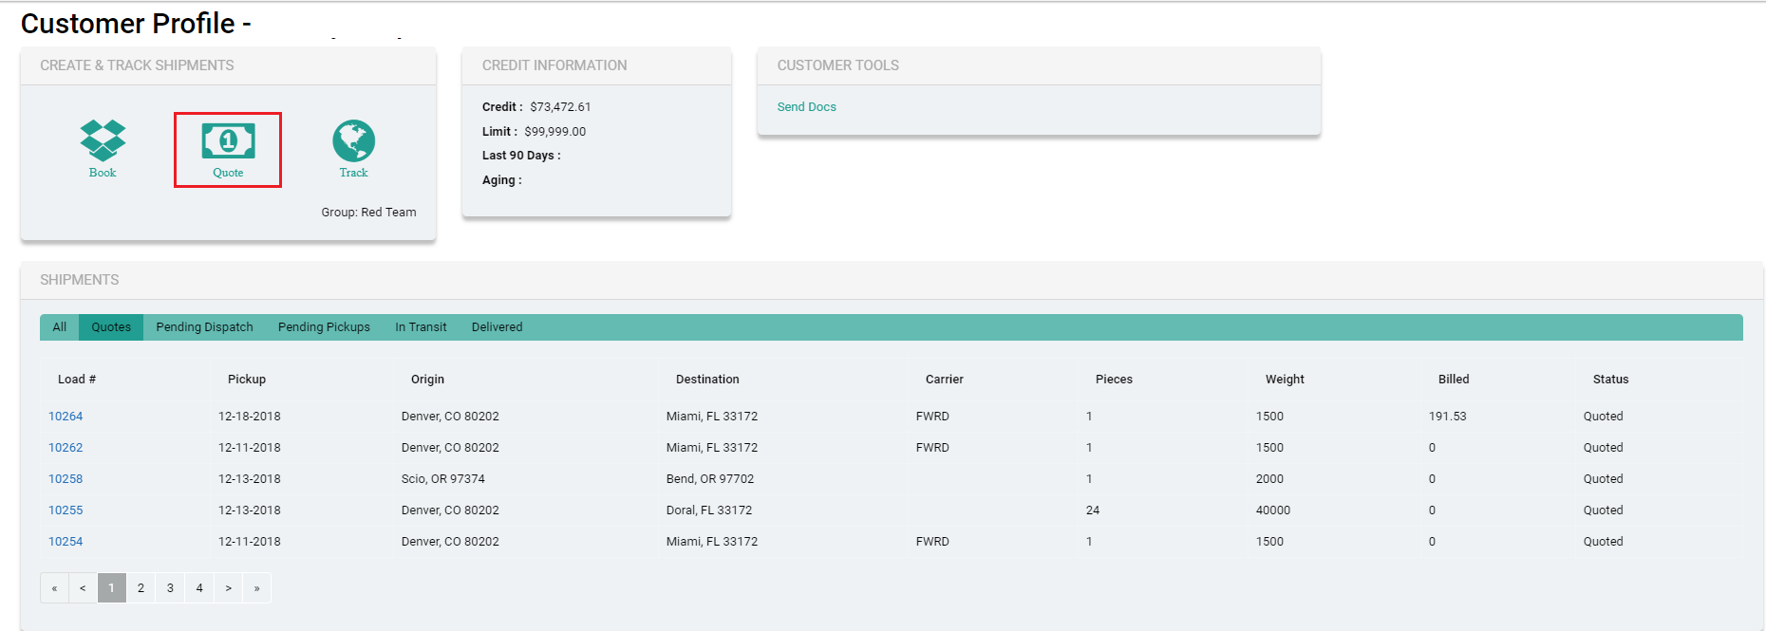
Obtain Quote from Customer Profile

Slide 5
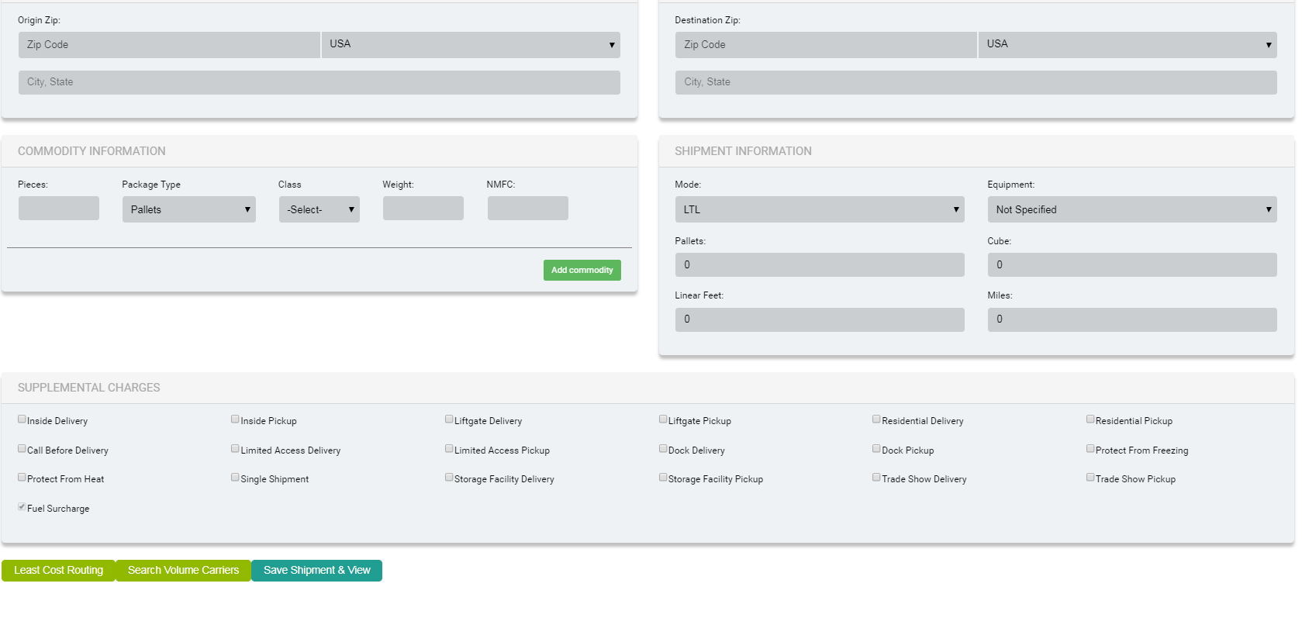
Quote Form

Slide 6
Order Entry- Book Shipment
Before any shipment can be tendered to a carrier, the Complete Form from Amark TMS must be completed. See next page for require info to generate Bill of Lading and to Tender (dispatch) a shipment(s) to a Carrier.

Slide 7
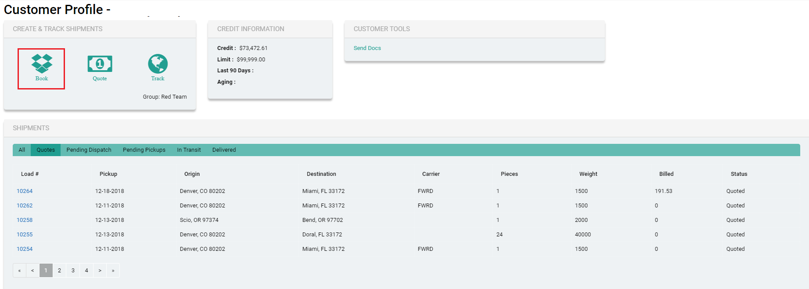
Order Entry Book Shipment From Customer Profile

Slide 8
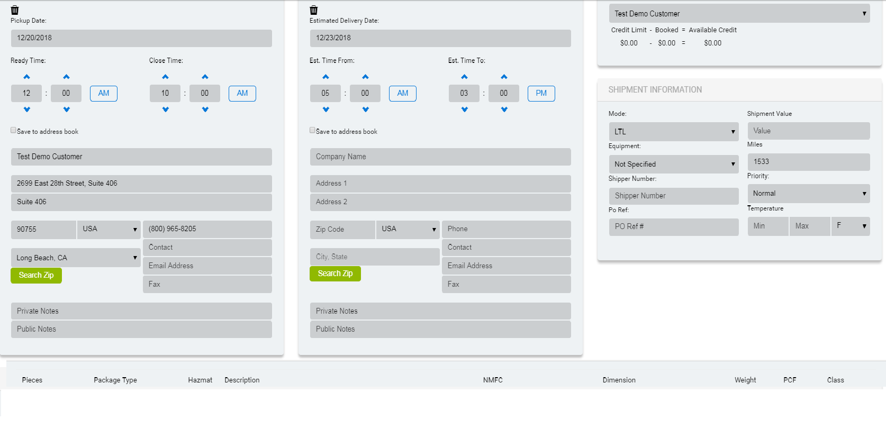
Order Entry – Required Info to Tender/BOL

Slide 9
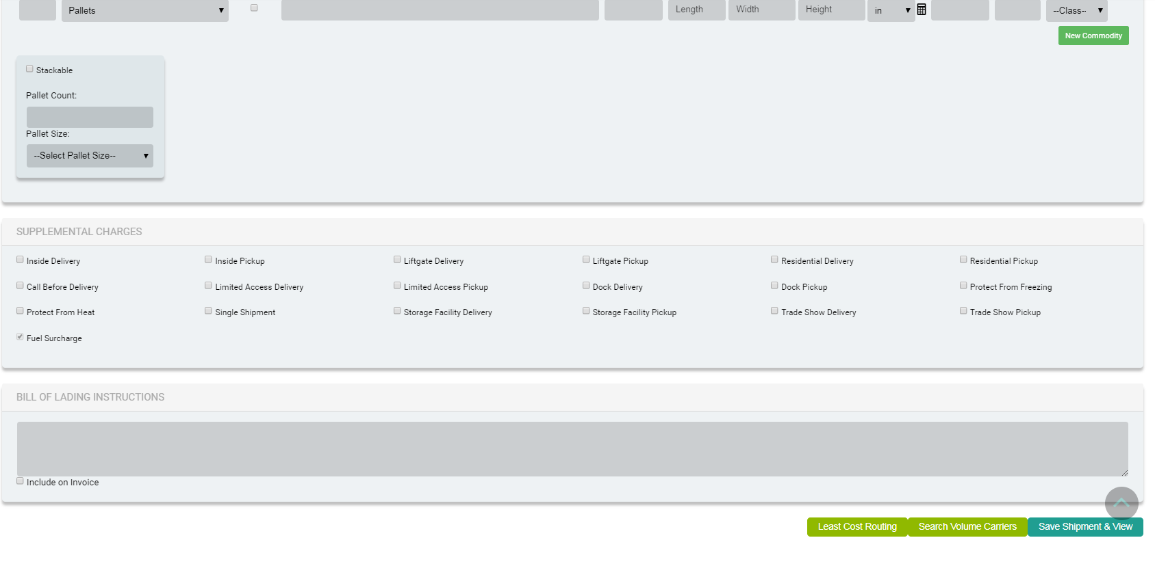
Order Entry Continued

Slide 10
Carrier Selection
The selection of a carrier can be automated based on your Business Rule ie; Least Cost or Least Transit or whatever you decide is the methodology you want to employ to route shipment(s).

Slide 11
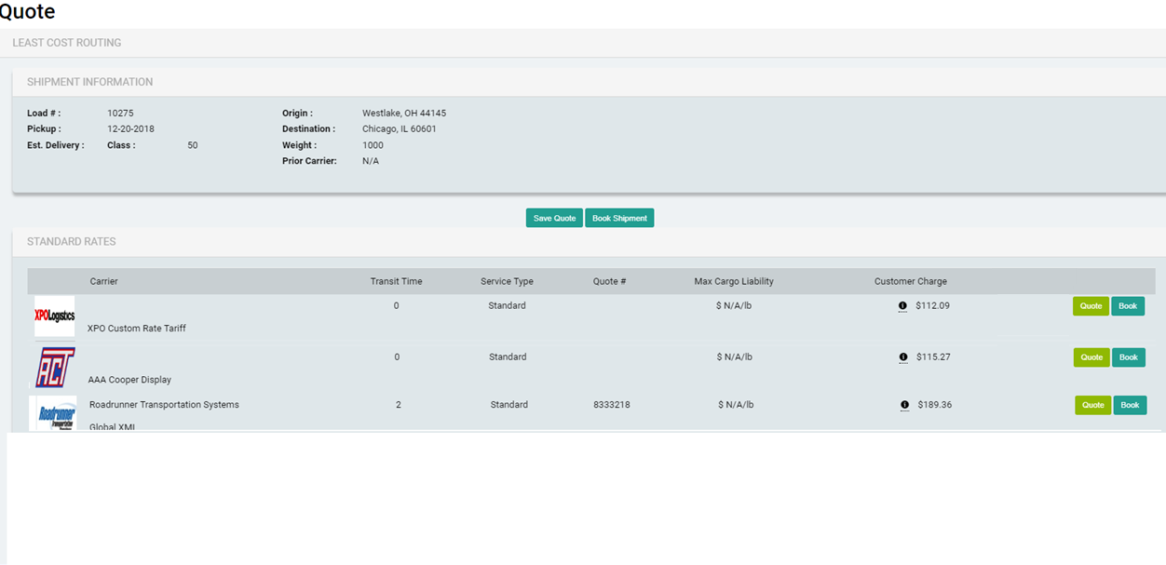

Slide 12
Management of Vendor Shipments
A Vendor Cannot Rate or Route a Shipment –
Vendors can only alert your or Amark Ops that they have a shipment that needs to be moved.
Vendors is provided with UN & PW and can log in to Amark TMS and Create shipment.
Amark Ops will ;
Verify Shipment Details- Including Ready Date -Time/ Commodity/NMFC/Freight Class
Rate/Select Carrier
Generate Bill Of Lading and Send to Vendor
Tender Shipment to Carrier – Automatically or by other means as mutually agreed upon.
Note Other methods of Vendor Notification may be available as mutually agreed Ie; Fax, Phone, Email

Slide 13
Bill Of Lading
The Bill of Lading is generated by the Amark TMS based on the Shipment Detail entered before load is “Booked” or communicated to Amark TMS as an active shipment.
It can be sent electronically via Fax or Email by you or Amark Ops. For Outbound shipments from your Location, the Bill of Lading can be printed from the Amark TMS.
For Inbound Shipments from a Vendor the Bill of Lading can be sent by your or Amark Ops as mutually agreed upon.

Slide 14
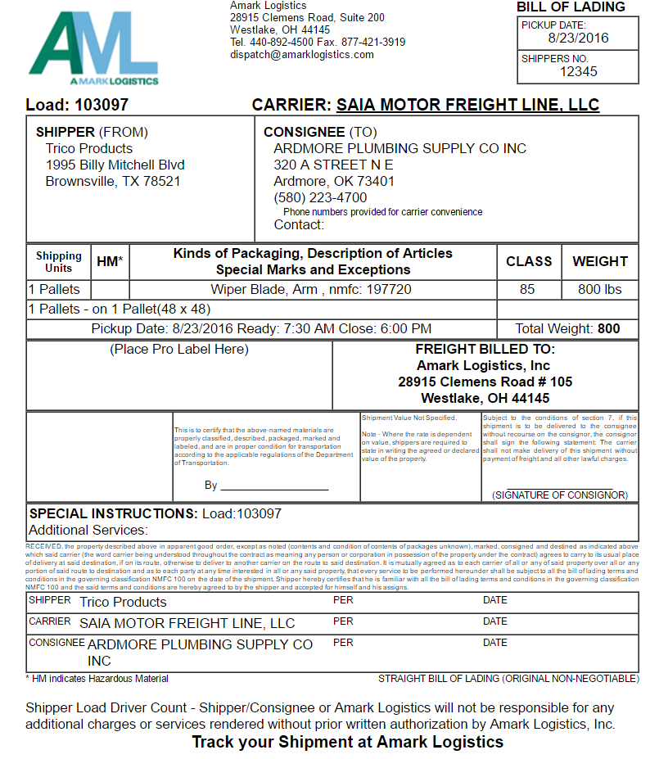

Slide 15
Shipment Tender (Book)
A carrier can be notified of a pick up in a number of ways by either you or by Amark Ops, as mutually agreed upon.
Options available to notify carrier(s);
Automated – EDI 204 or API Electronic Pickup Notice (ASN)
Entered manually on Carrier Website by you or Amark Ops
Phone Call to Origin Terminal
Fax or Email of Pickup to Carrier Dispatch

Slide 16
Confirmation of Pickup
Pickups can be confirmed a number of ways by you or EDI 214 via Amark TMS or By Amark Ops, as mutually agreed.
You -Enter PRO # as shipment is picked up either in Shipment Profile or from your Home Page. Doing so will begin the automated Tracking process immediately upon pickup.
Anything that can be automated via EDI 214 or API Tracking occurs over night. The Carriers EDI or API makes a match based on multiple shipment details, assigns the Pro # in the Amark TMS and Automatically changes shipment status.
Amark Ops – Pro # information is generally not otherwise available until the morning after a shipment has been picked up. Any shipments that do not have a Pro # assigned are monitored by Amark Ops and Pro #’s are assigned as obtained.

Slide 17
Tracking Status Updates
Tracking Status updates are automated and update via EDI 214 or API Tracking at various intervals which are governed by the individual carrier.
Some carriers update based on change of Status only while others will provide periodic geographic location updates.
Amark Ops monitors Status updates and will intervene as necessary when a shipment is more than one day past the expected delivery date, unless other arrangements ie; Guaranteed Delivery or Expedite have been made.
The timing of notification to you regarding past due deliveries will be mutually agreed upon in advance.
Tracking info for all shipments is available to you via Amark TMS 24/7

Slide 18
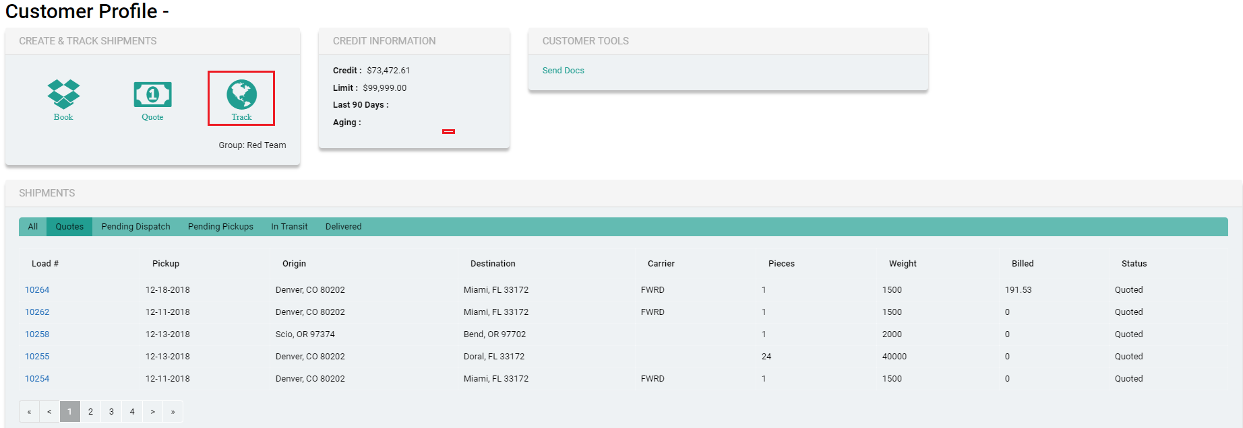
Track Shipment(s) From Customer Profile

Slide 19
Confirmation of Delivery
A number of notifications (based on Shipment Status) are available on an automated basis to your through the Amark TMS, including a notification when shipment(s) are delivered.
In the event you did not want to receive individual notifications for each load there is a Tracking Icon (Link) on the home page and you can search for all shipments delivered by Date Range.

Slide 20
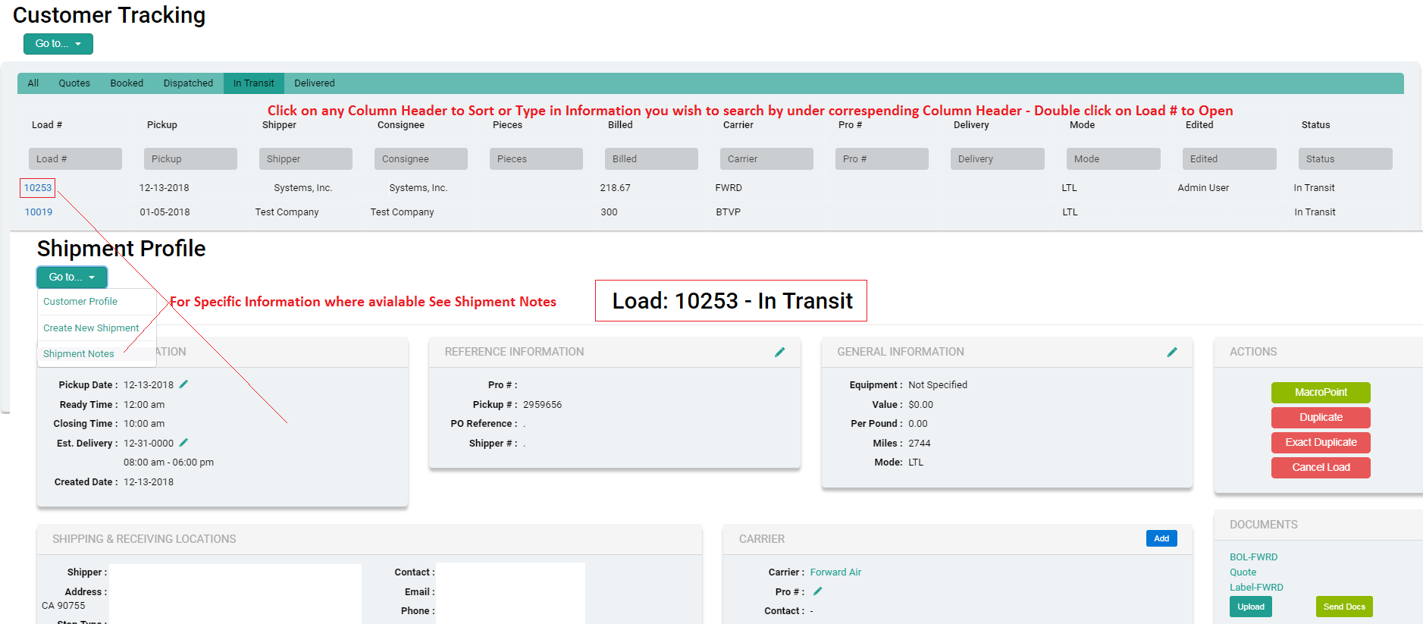
Customer Tracking Sort, Search, View Shipment

Slide 21
Freight Bill Audit and Pay
Freight Bill Audit and Pay is facilitated independently by ITS Traffic Systems, Inc.
All Shipments entered in the Amark TMS are sent daily to ITS Traffic Systems, Inc via FTP for Freight Bill Processing. The data from Amark TMS could function as a BOL and/or PO match with actual expected charges with the ITS FAP System.
ITS Traffic Systems, Inc. would remain the Funding Request source for all carriers.

